Slide 1


Cognitive overload & Reducing load
Batch-10
241fa04729- Arshiya
241FA04121- Hima bindu
241FA04813- Shaista
241FA04B94- Gagan
Department of CSE UI/UX Design

Slide 2
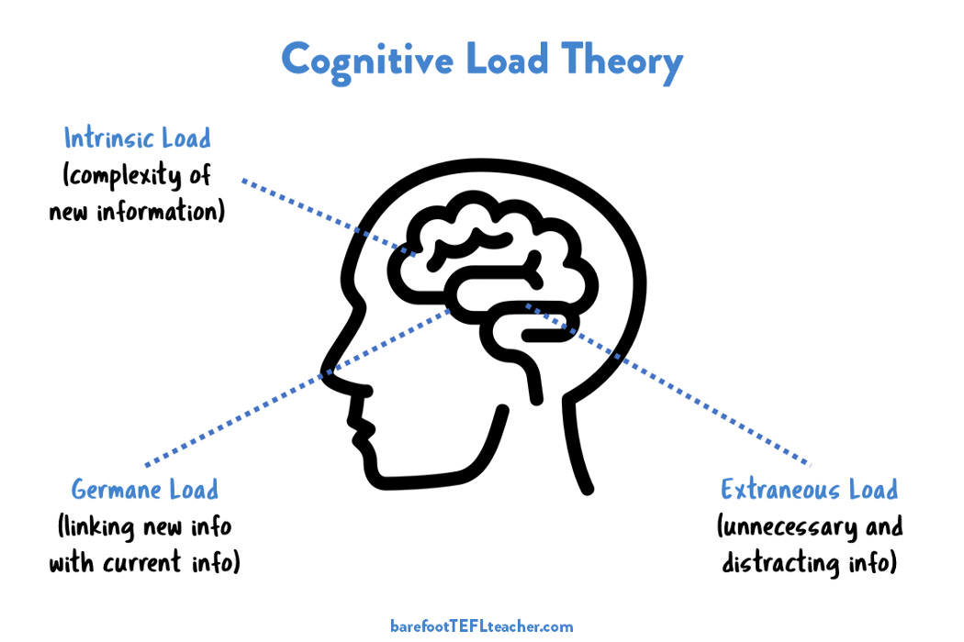
What is Cognitive Load?
Cognitive load is the amount of mental effort used in the working memory while learning.Brain can handle only limited information at a timeToo much information creates confusion Learning becomes difficult.
Types of Cognitive Load :
3 types of cognitive load
Intrinsic load:
Difficulty of the topic
Extraneous Load :
Poor way of presenting information
Germane Load :
Effort used for learning

Slide 3
Effects of Cognitive Overload
Memory loss
Slow learning
Poor performance
Frustration

Slide 4

Signs of Cognitive Overload:
Difficulty in concentrating or remembering
Mental fatigue or irritability
Headaches or poor sleep
Sensitivity to noise or light
Department of CSE UI/UX Design

Slide 5

What is Reducing Cognitive Load?
Reducing cognitive load means presenting information in a simple and clear way for easy understanding
easy understanding.
Make learning easy
Improve memory
Increase focus
Department of CSE UI/UX Design

Slide 6

Techniques to Reduce Cognitive Load
Use simple language Break content into small parts.
Use bullet points.
Use diagrams and icon.
Avoid unnecessary details
Use bullet points instead of paragraphs
Present one idea at a time.
Use headings and subheadings.
Department of CSE UI/UX Design

Slide 7
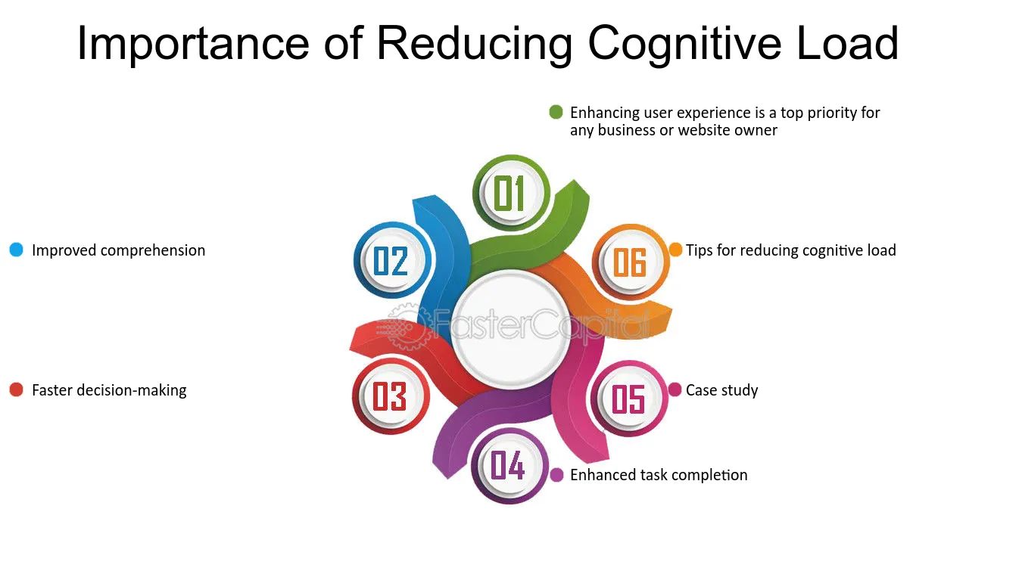

Slide 8

Benefits of Reducing Cognitive Load:
Increases memory retention
Saves learning time
Reduces stress and confusion
Improves focus and attention
Makes learning interesting and effective
Conclusion:
Cognitive overload reduces learning ability.By organizing and simplifying information, we can reduce cognitive load and improve understanding

Slide 9


